Slide 1
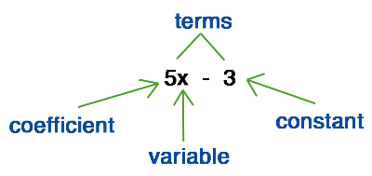
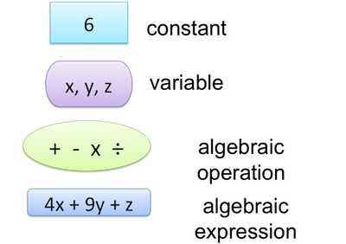
My Algebra Interactive Notebook
Name
Class
Teacher Mr Martin
Term 2 Semester 1
1

Slide 2
Contents
Glossary or Formula Page
Page
Date
Description
2
3

Slide 3
Tasks
24
7
30
Essential Question
Questions
Notes
Summary

Slide 4
24
7
30
Date
Substitution
EQ – Why do we need to substitute values into an algebraic expression?
When values for pronumerals are substituted into an expression and a result is worked out, this is called evaluating the expression.
When you substitute values and evaluate expressions, remember the rules for directed numbers and order of operations (BIMDAS).

Slide 5
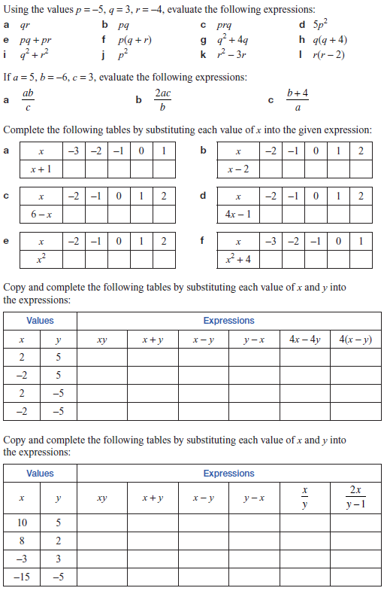
Task

Slide 6
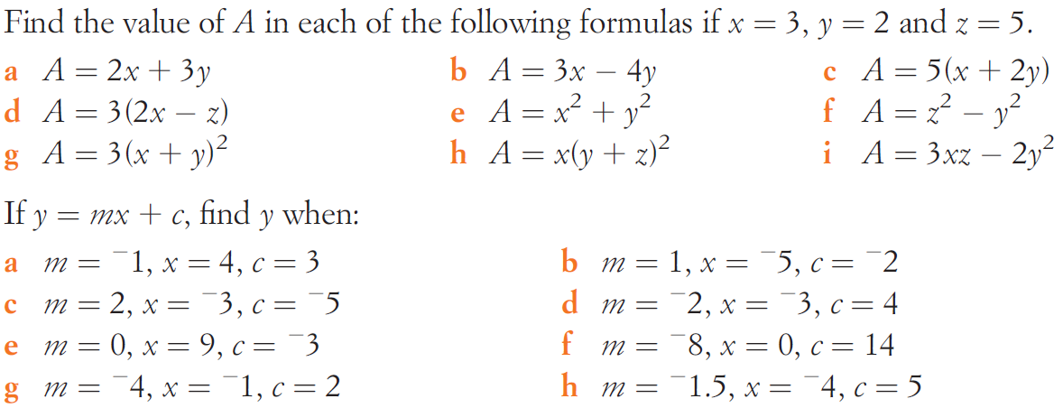
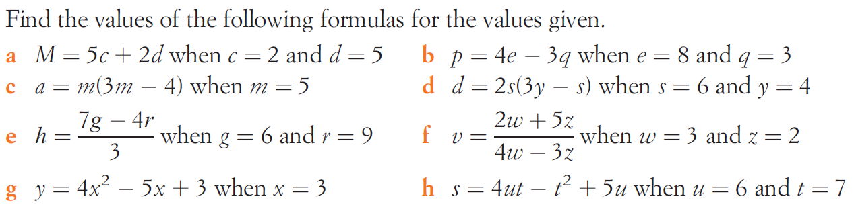
Task

Slide 7
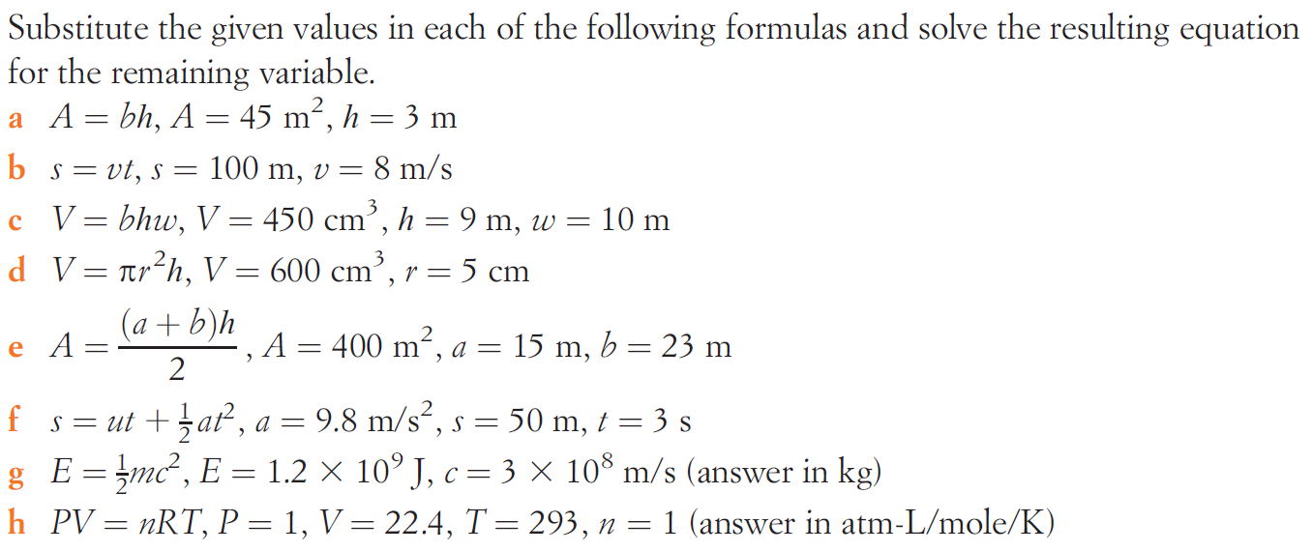
Task

Slide 8
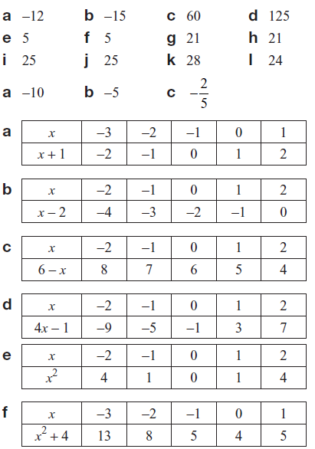
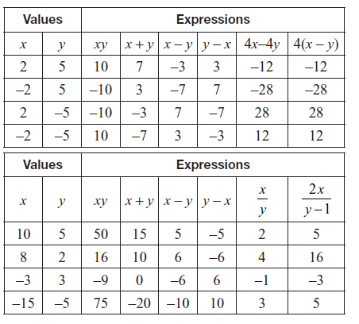
Answers

Slide 9
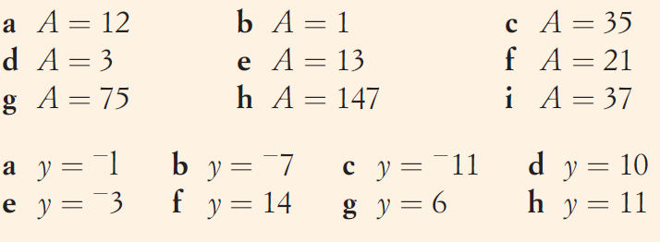
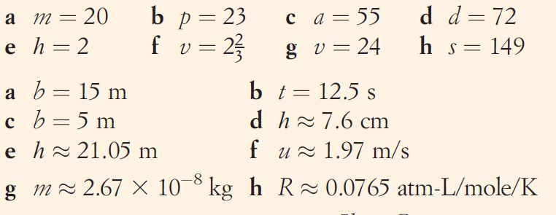
Answers

Slide 10
Notes Review
24, 7 ,30
Date
Title
Essential question
Notes complete
Notes complete with colour and diagrams
Questions completed
Contents page filed in
Formula page filled in

Slide 11
Homework
Review your notes and write a summary answering the essential question.

